Slide 2
Dealing with Incident Response & Digital Forensics

Slide 3
Syllabus Objectives Covered
4.2 Summarize the importance of policies, processes, and procedures for incident response
4.5 Explain the key aspects of digital forensics

Slide 4
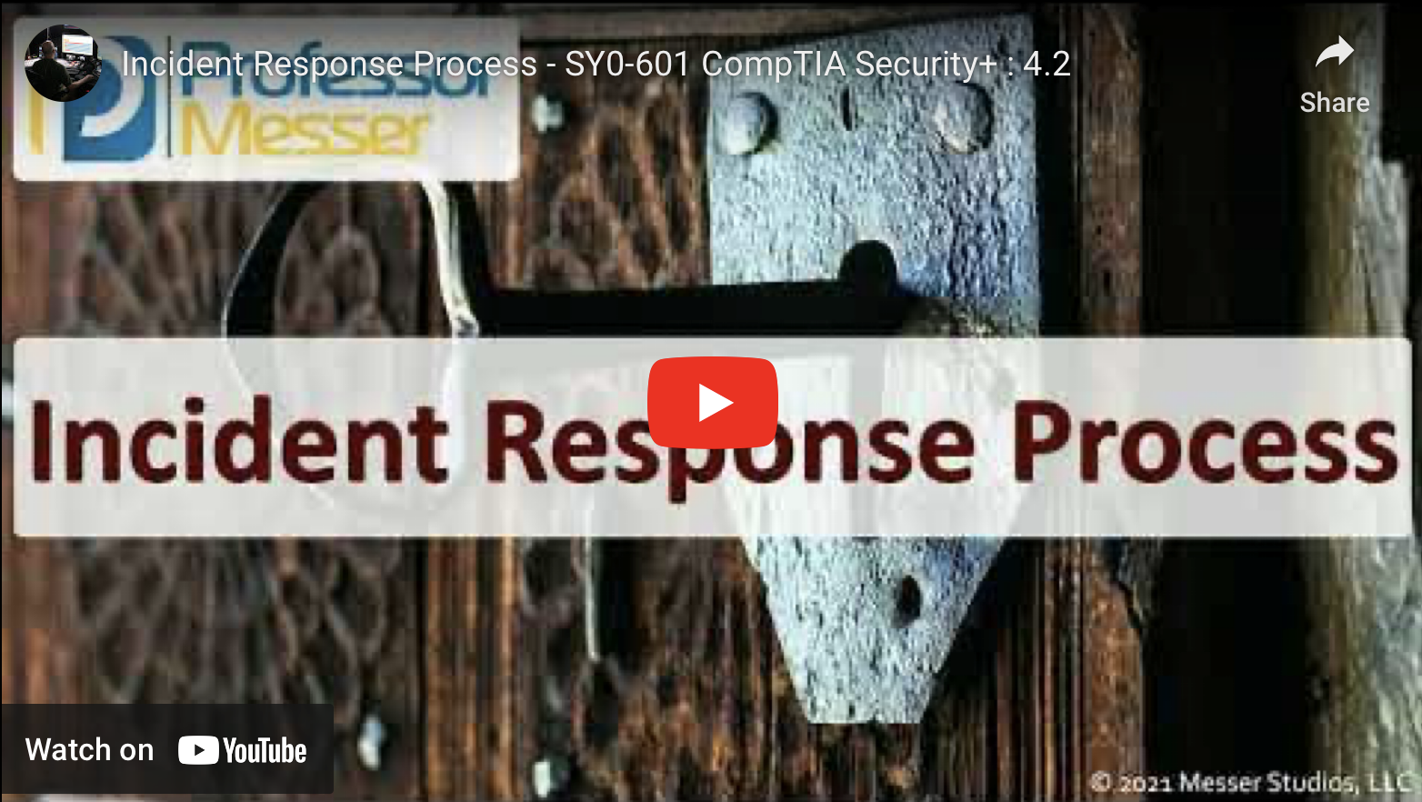
Professor Messer: The Incident Response Process

Slide 5

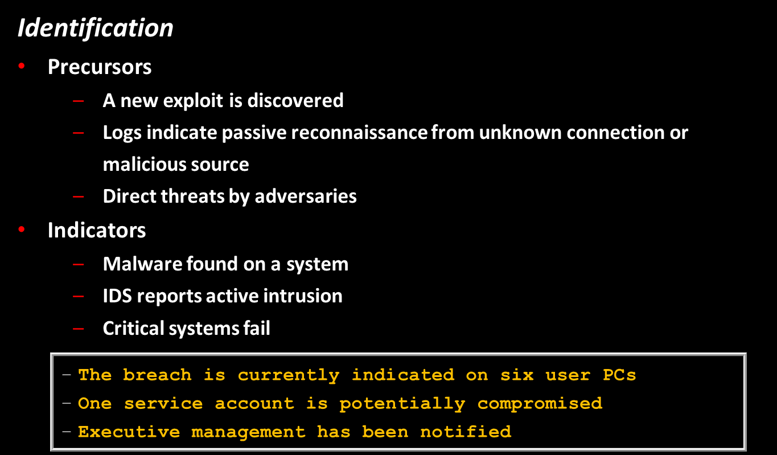
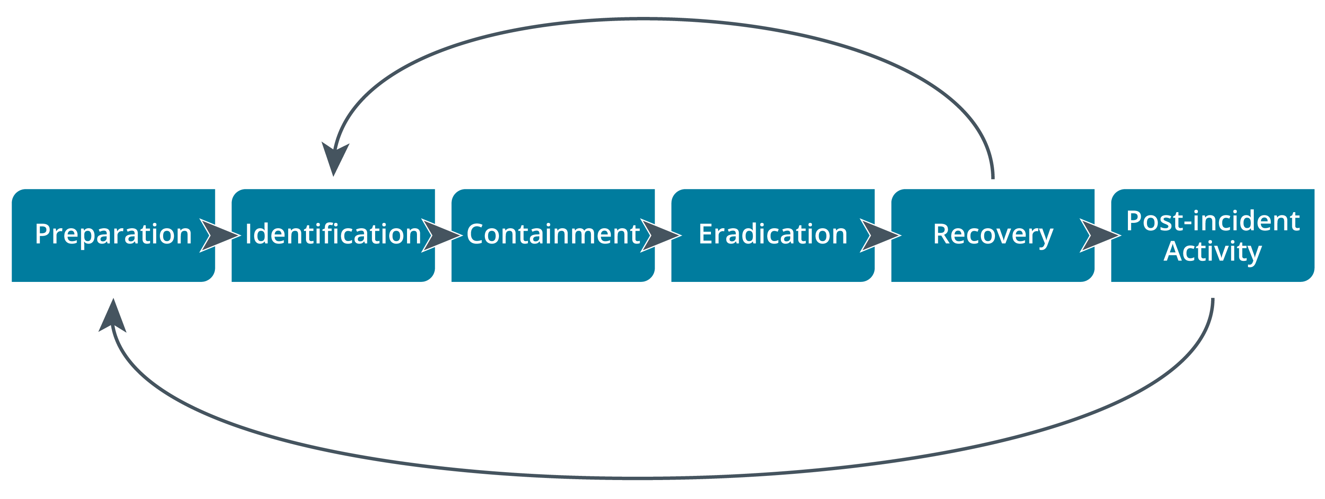
Incident Response Process

Slide 6
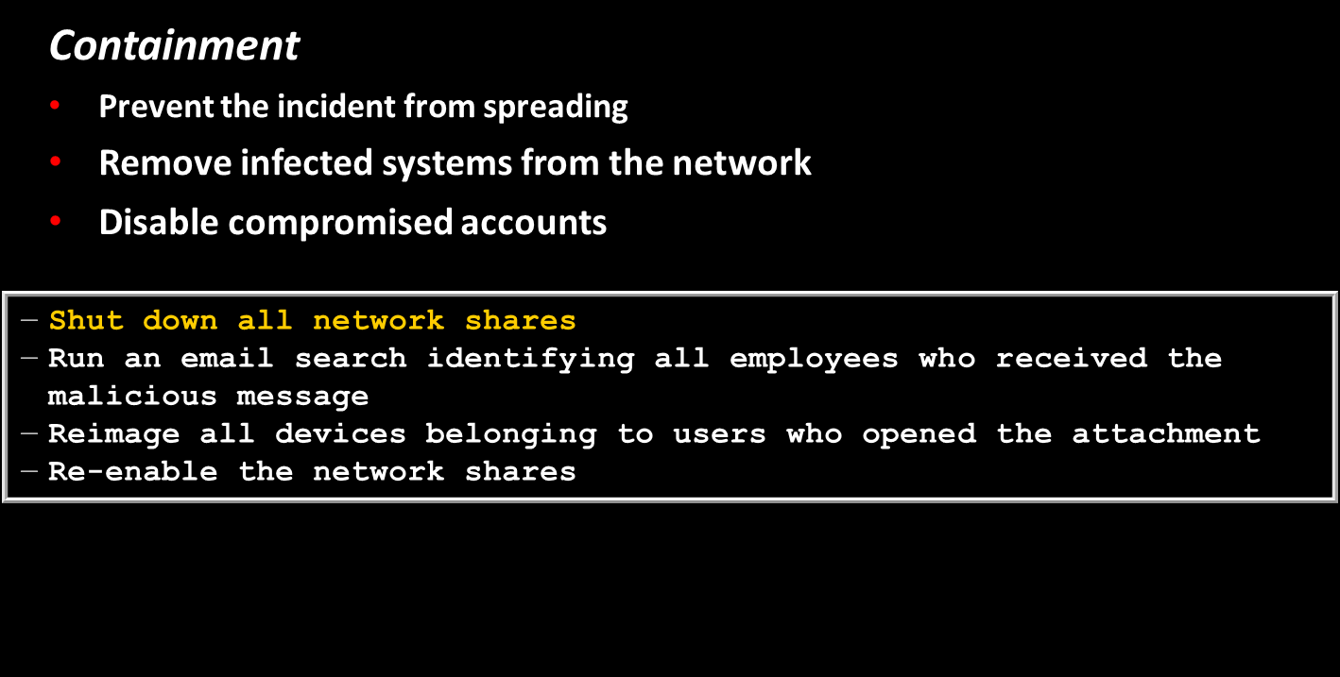
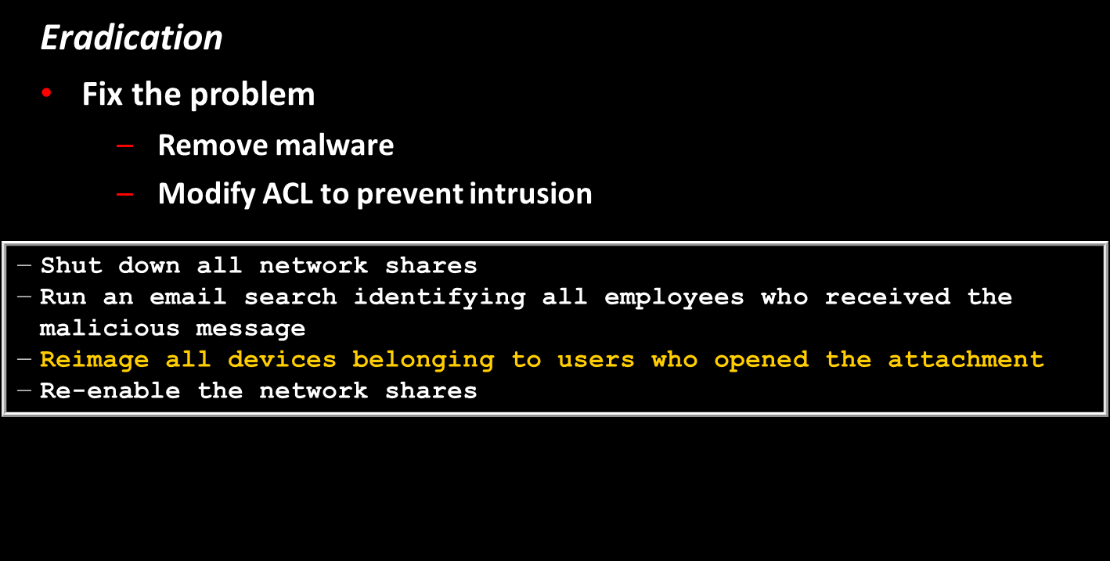
Incident Response Process

Slide 7
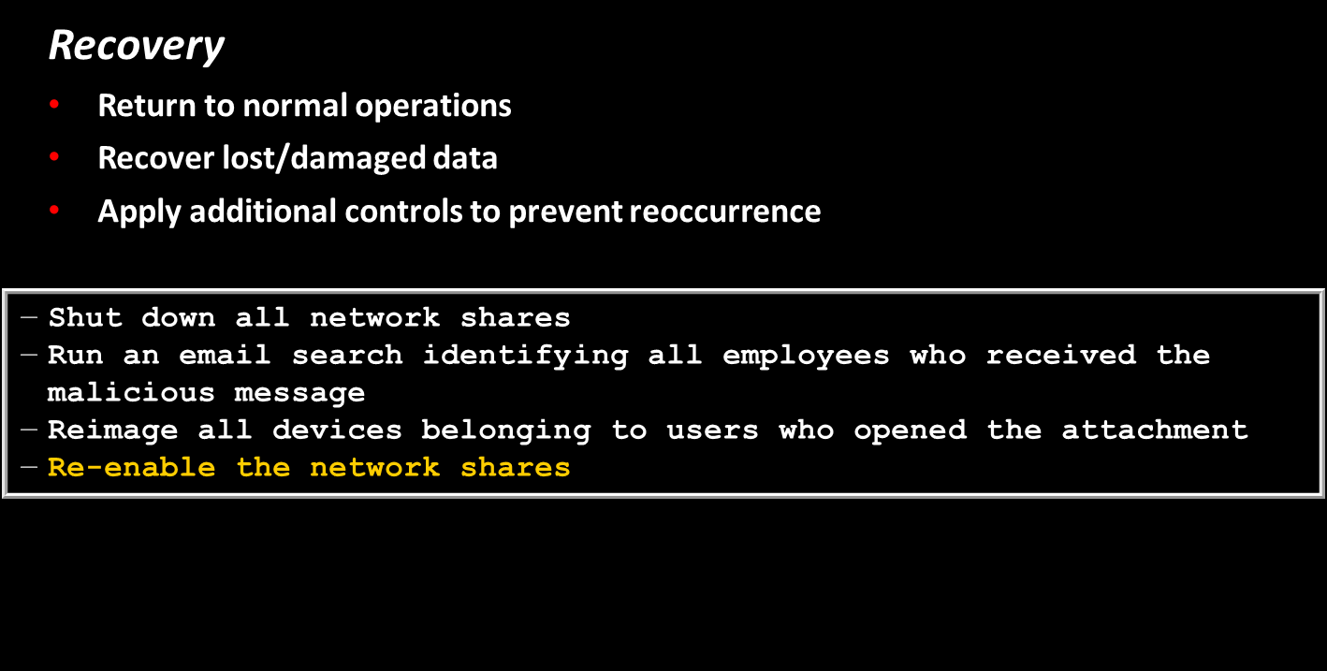

Incident Response Process
Post-incident Activity
7

Slide 8

Cyber Incident Response Team
Reporting, categorizing, and prioritizing (triage)
CIRT/CERT/CSIRT/SOC
Management/decision-making authority
Incident analysts
24/7 availability
Roles beyond technical response
Legal
Human Resources (HR)
Marketing
Image credit: John Mattern/Feature Photo Service for IBM.

Slide 9
Incident Response Plan
Incident Response Plans
Lists the procedures, contacts, and resources available to responders for various incident categories
Playbooks and runbooks
Incident categorization
Prioritization factors
Data integrity
Downtime
Economic/publicity
Scope
Detection time
Recovery time

Slide 10
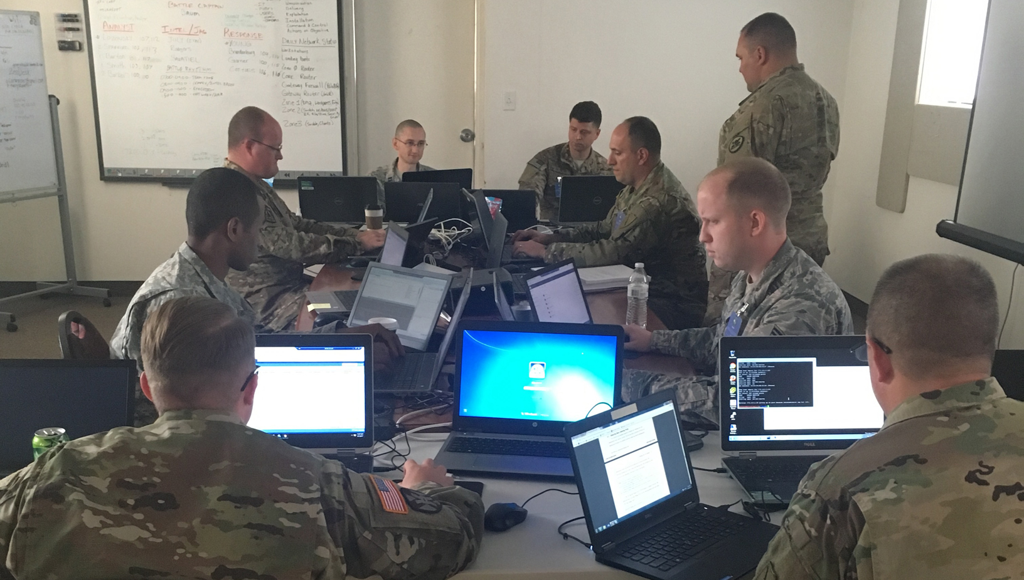
Incident Response Exercises
Tabletop
Facilitator presents a scenario
Does not involve live systems
Walkthroughs
Responders demonstrate response actions
Simulations
Red team performs a simulated intrusion
Image © 2017 Kentucky National Guard.

Slide 11
Incident Response, Disaster Recovery, and Retention Policy
Incident response versus disaster recovery and business continuity
Disaster recovery plan
Response and recovery planning for major incidents
Business continuity plan
Making business procedures resilient
Continuity of operation planning (COOP)
Incident response, forensics, and retention policy
Digital forensics requirements
Retention policies for evidence preservation

Slide 12
Answer the questions…
A cybersecurity manager has scheduled biannual meetings with the IT team and department leaders to discuss how they would respond to hypothetical cyberattacks. During these meetings, the manager presents a scenario and injects additional information throughout the session to replicate what might occur in a dynamic cybersecurity event involving the company, its facilities, its data, and its staff. Which of the following describes what the manager is doing?
Developing an incident response plan
Building a disaster recovery plan
Conducting a tabletop exercise
Running a simulation exercise
﻿True or false? It is important to publish all security alerts to all members of staff.
True or false? The "first responder" is whoever first reports an incident to the CIRT.
Notes:
Answers
1. C
2. False—security alerts should be sent to those able to deal with them at a given level of security awareness and on a need-to-know basis.
3. ﻿False—the first responder would be the member of the CIRT to handle the report.

Slide 13

QUESTIONS?

Slide 14
Preservation and Integrity of Evidence
Control & Preservation of evidence
Preserve and secure the scene
Secure tamper-evident bagging
Secure storage facility
Protection against electrostatic discharge (ESD)
Chain of custody
Legal Hold

Slide 15
Preservation and Integrity of Evidence
Provenance
Record process of evidence acquisition
Use a write blocker (WORM drive)
Logs from a SIEM system can be backed up onto a WORM drive
Storing files on a worm drive prevents deletion
Hardware or software tool should be used whenever you are capturing a system image to preserve the integrity of the original media
Data acquisition with integrity and non-repudiation
Cryptographic hashing and checksums
Take hashes of source device, reference image, and copy of image for analysis
Forensic copy
Copy of a system image for forensic use
Collect evidence from laptops and desktops
Original image is kept intact, a copy is used for analyzation
System is analyzed for evidence of any criminal activity
dd- Linux command to create a copy of an image

Slide 16
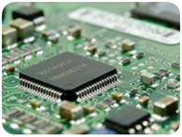

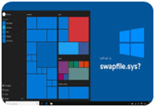
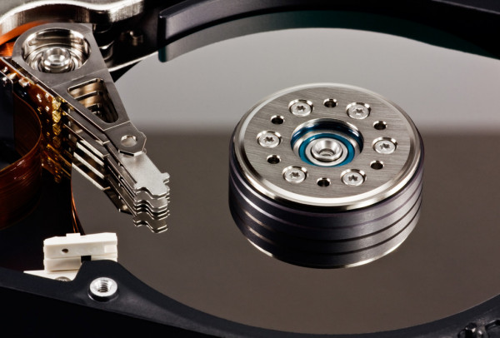


4.5 Explain the key aspects of digital forensics
Order of Volatility
Cache Memory
Random Access Memory (RAM)
Page file (Windows) / Swap file (Linux)
Hard drive
Archived media
Network Traffic & Logs
Cache Memory
RAM
Page/Swap file
Hard Drive
Archived Media
Network Traffic & Logs
Notes:
https://www.techtarget.com/searchwindowsserver/definition/swap-file-swap-space-or-pagefile

Slide 17

Professor Messer: Managing Evidence
Notes:
https://www.youtube.com/watch?v=Efu-hT8D_AM
https://www.youtube.com/watch?v=MlGuR5NIDio
https://www.youtube.com/watch?v=GetMhBHx-BA

Slide 18
E-discovery
Electronically Stored Information (ESI)
Identify and de-duplicate files and metadata
Search
Tags
Security
Disclosure

Slide 19
Digital Forensics Software
EnCase Forensic and The Forensic Toolkit (FTK)
Commercial case management and evidence acquisition and analysis
The Sleuth Kit/Autopsy
Open-source case management and evidence acquisition and analysis
WinHex
Forensic recovery and analysis of binary data
The Volatility Framework
System memory analysis

Slide 20
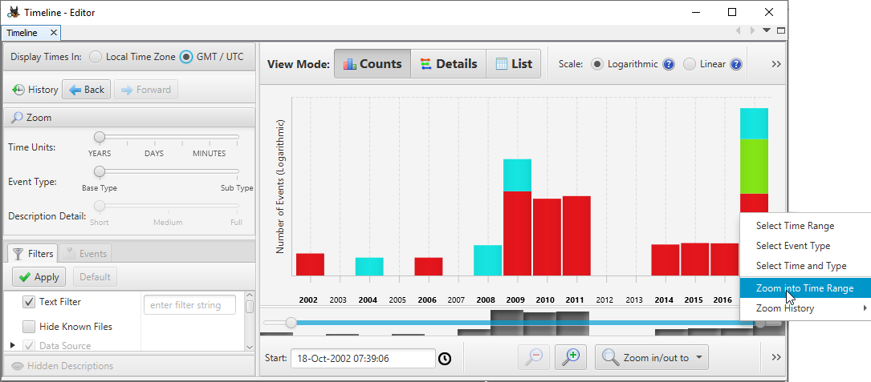
Timelines
Sequence of events
Time stamps
OS/file system methods for recording time
Correct synchronization of local time source
Time offset / Time normalization
Coordinated Universal Time (UTC)
Local time
Date/time settings tampering
Screenshot: Autopsy - the Sleuth Kit (sleuthkit.org/autopsy.)

Slide 21
Digital Forensics Evaluation & Reports
Evaluation Evidence
Strategic intelligence/counterintelligence gathering
Active logging
Tracking man hours
Recovery
Mitigate the attack and get the system back up and running
Reports
Summarizes contents of the digital data
Conclusions from the investigator's analysis
Professional ethics
Analysis must be performed without bias
Analysis methods must be repeatable
Evidence must not be changed or manipulated

Slide 22
Digital Forensics for Cloud
Right to audit clauses
Limited opportunities for recovery of ephemeral images
Ability to snapshot instances
Recover log and monitoring data
Complex chain of custody issues
Complex regulatory/jurisdiction issues
Data breach notification laws

Slide 23
Answer the questions…
A security administrator suspects an employee has been emailing proprietary information to a competitor. Company policy requires the administrator to capture an exact copy of the employee’s hard disk. Which of the following should the administrator use?
dd
chmod
dnsenum
Logger
On which of the following is the live acquisition of data for forensic analysis MOST dependent? (Choose two.)
Legal hold
Cryptographic or hash algorithm
Data retention legislation
Value and volatility of data
Right-to-audit clauses
Notes:
Answers
1. a
2 d and e

Slide 24
QUESTIONS?

Slide 25
Syllabus Objectives Covered
4.2 Summarize the importance of policies, processes, and procedures for incident response
4.5 Explain the key aspects of digital forensics

